Slide 1

MAJOR PROJECT(15EE496L) ON IRIS and VOICE based MOTORIZED wheelchair (vision chariot) Project Guide- Mr. Ram Niwash MAHiA

Slide 2
EYE DETECTION SYSTEM
This basically uses a pre-defined algorithm for face detection known as voila-jones algorithm.
Basically it captures the face of the operator then algorithm zooms in towards the face to identify the eyes feature.
The pupil is thereafter segregated in terms of radius formed around it .
The distance of center of pupil is calculated with the reference point and accordingly direction of movement is achieved.

Slide 3
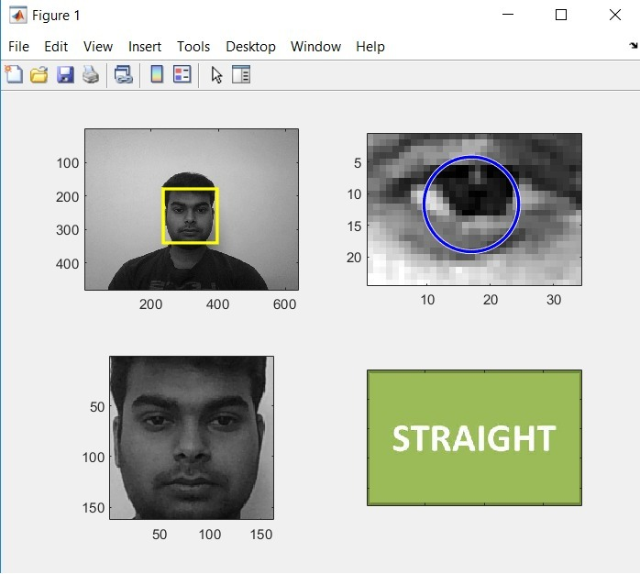
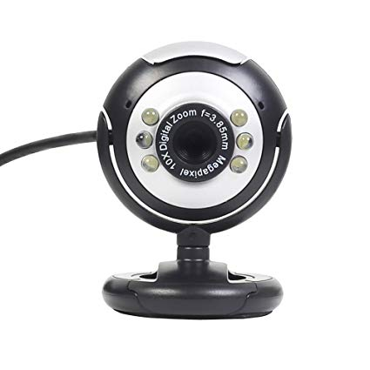
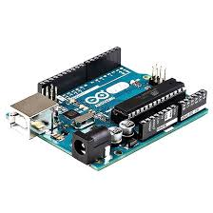


webcam
Matlab script
Processing the image
MATLAB CONSOLE
Dc geared motor

Slide 4
Commands
The following commands are recognized by the MATLAB according to our pupil movement
Forward
Back
Right
Left
These position are adjusted according to different person as distance of pupil from refrence point on our eye will differ for different postion.

Slide 5
SWITCH MODE
Each time we switch on the circuit the lcd 16*2 displays the mode in which the wheelchair would run.
When in mode: EYE the commands recognized would be displayed accordingly.
Similarly in mode: voice the valid commands would be processed and movement is made accordingly.

Slide 6
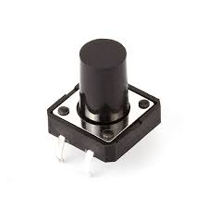
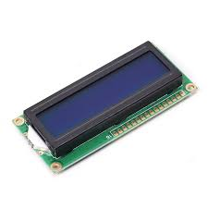
LCD USAGE
It displays the following
The current mode in which the chair is being operated .
The direction being recognized by the microcontroller.
PUSH BUTTON
LCD 16*2

Slide 7
Voice recognition mode
The voice recognition module is basically consisting of a mic to take the input and it is fed to the Arduino.
Now first before actual recognition this module need to be trained with help of it’s DATA SHEET CODE provided and serial interface.
Thereafter this commands are linked to main code where forward means both motor high and similarly for right and left.
There is SLEEP command in which the servo motor stretches the back panel to a bed shape.

Slide 8
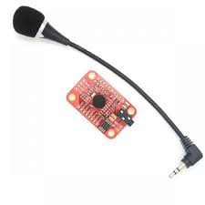
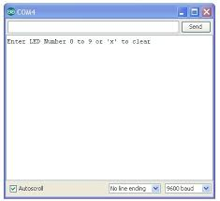
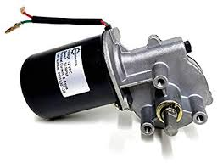
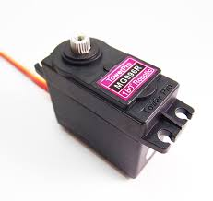
VOICE RECOGNITION FLOW
.
VR MODULE
MAIN WHEEL(DC GEARED MOTOR
SERIAL MONITOR
Servo motor for bed mode

Slide 9
COMMANDS OF VOICE MODULE MODE
The following commands are recognized by the vr module:
Forward
Back
Right
Left
Sleep
The commands forward would initiate a forward motor turn and respectively other commands like left, right and so on.
The ‘sleep’ command would initiate the back panel servo motor to roll out to take a shape of bed.

Slide 10
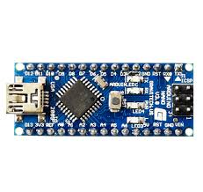
SAFETY FEATURE
There is safety feature installed separately controlled by Arduino nano board
In this there are following components
GSM MODULE
GPS MODULE WITH ANTENA
ACCELEROMETER SENSOR
In this setup when there is fall i.e when wheelchair falls then this fall is detected by the sensor.
This sensor sends signal to GPS module that encodes the location in latitude and longitude form.
Threreafter this location is sent to registered number via GSM module.
ARDUINO NANO

Slide 11
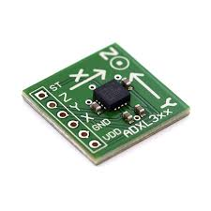
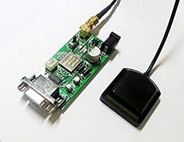
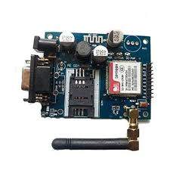
FLOW OF THE SAFETY FEATURE
ACCELEROMETER
GPS MODULE
GSM MODULE
ARDUINO NANO

Slide 12
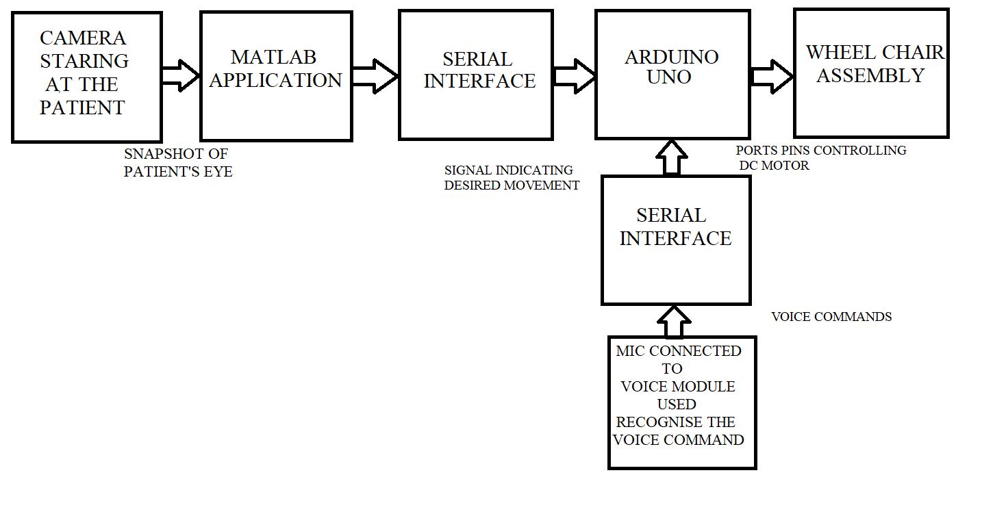
FINAL FLOW DIAGRAM

Slide 13
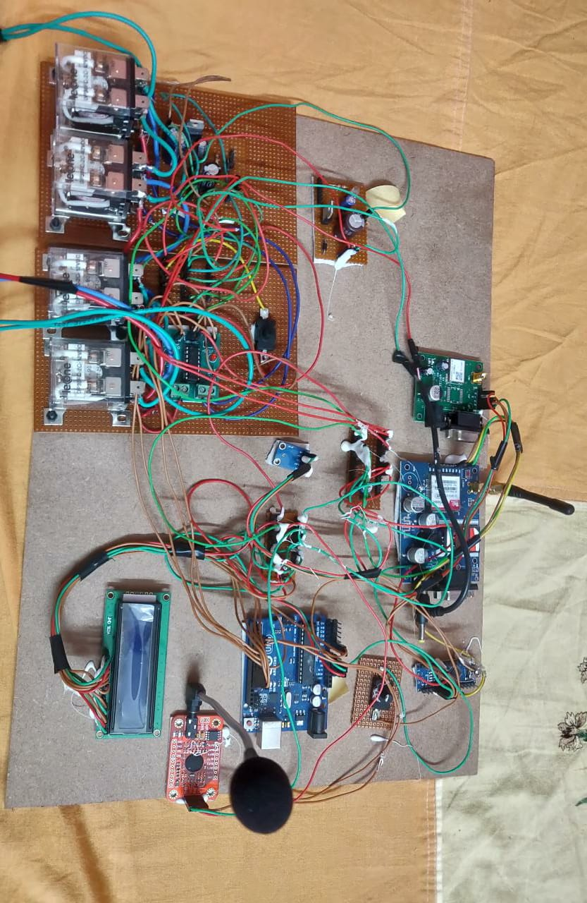
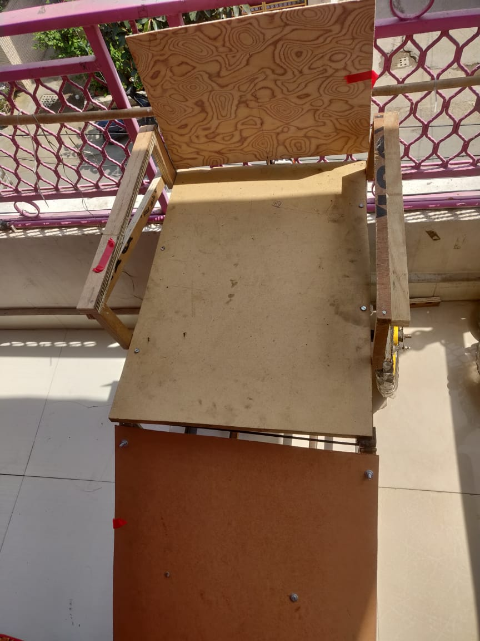
FINAL PROJECT SETUP
WHEEL CHAIR CIRCUITRY
WHEEL CHAIR FRAME

Slide 14
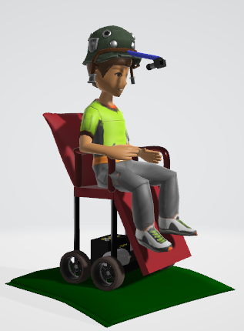
SUBMITTED BY:
JOYDEEP MUKHERJEE (RA1511005030028)
AJISHAN JOSE (RA1511005030029)
HIMANSHU GOEL (RA1511005030037)

